Slide 1
Generative Adversarial Networks
Zhang Huangzhao, Yuan Pei College

Slide 2
Overview
Generative models vs. Discriminative models
Generative Adversarial Nets (GAN)
Wasserstein Generative Adversarial Networks (WGAN)
WGAN with Gradient Penalty

Slide 3
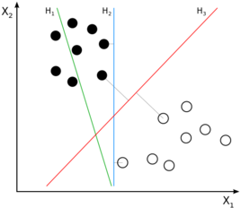
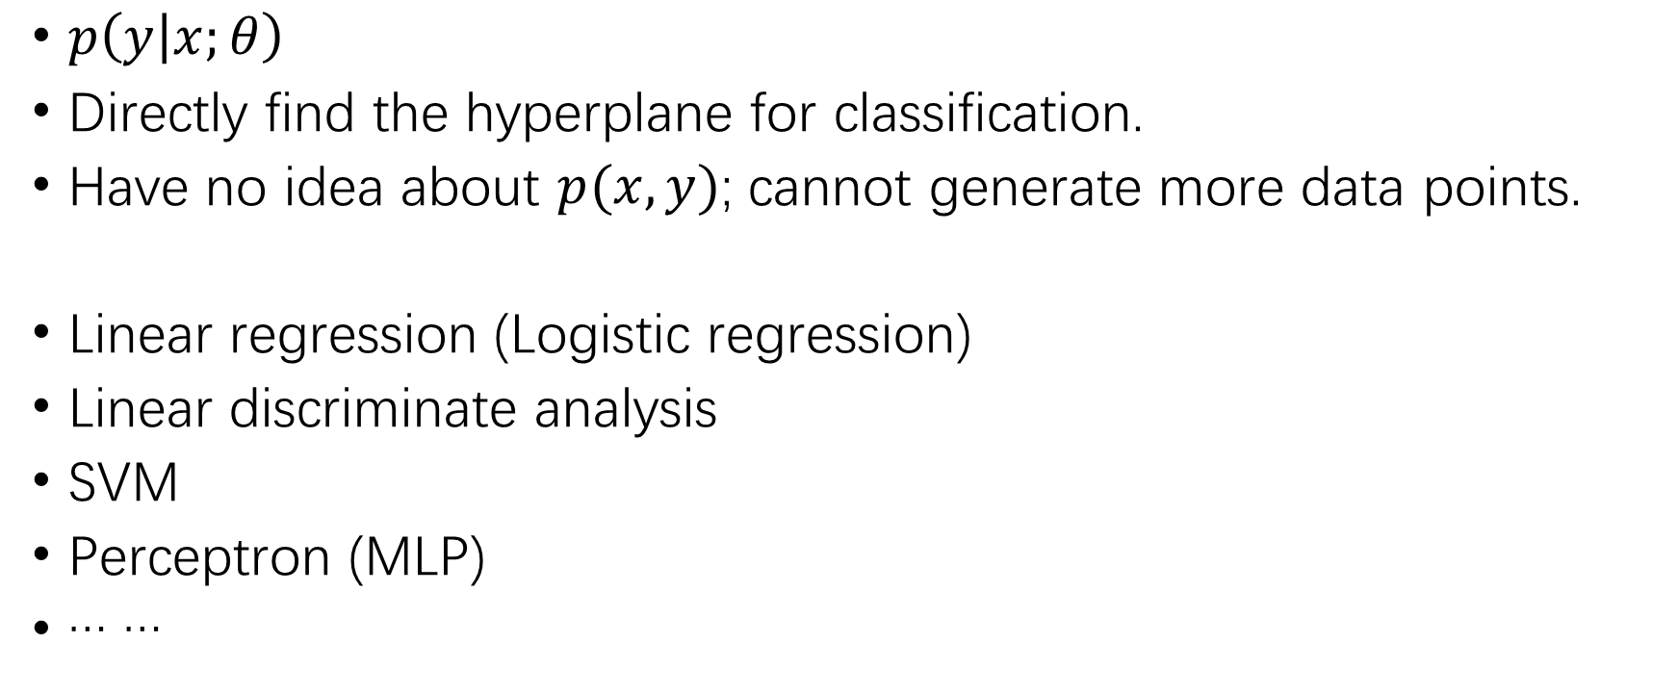
Discriminative Models
$p\left(y | x;θ\right)$
Directly find the hyperplane for classification.
Have no idea about $p(x, y)$; cannot generate more data points.
Linear regression (Logistic regression)
Linear discriminate analysis
SVM
Perceptron (MLP)
… …

Slide 4
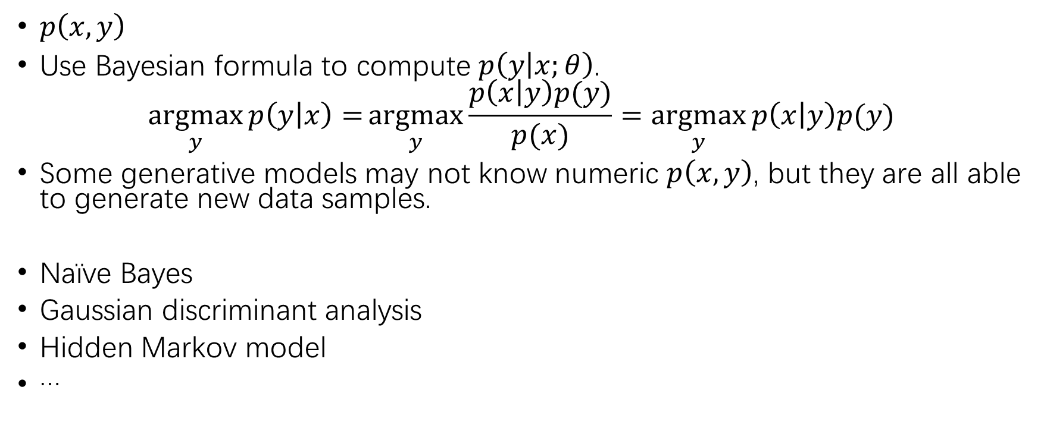
Generative models
$p\left(x, y\right)$
Use Bayesian formula to compute $p\left(y | x;θ\right)$.
$$\underset{y}{argmax}{p\left(y | x\right)=}\underset{y}{argmax}{\frac{p\left(x | y\right)p(y)}{p(x)}}=\underset{y}{argmax}{p\left(x | y\right)p(y)}$$
Some generative models may not know numeric $p\left(x, y\right)$, but they are all able to generate new data samples.
Naïve Bayes
Gaussian discriminant analysis
Hidden Markov model
…

Slide 5
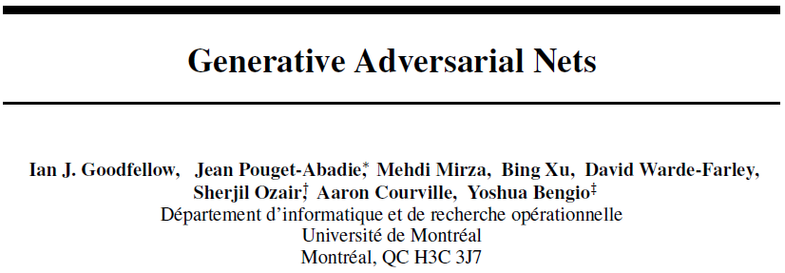
Generative Adversarial Nets (GAN)

Slide 6
Brief Idea of GAN
Discriminator (D) – A discriminative model that determines whether a sample is from the real distribution or the model distribution.
Generator (G) – A generative model that generates samples from the model distribution, which is as similar to the real distribution as possible.
Adversary – The two models compete with each other, and the competition drives both models to improve their performance, until the generator is indistinguishable.
Special case – G and D are both MLP’s,

Slide 7
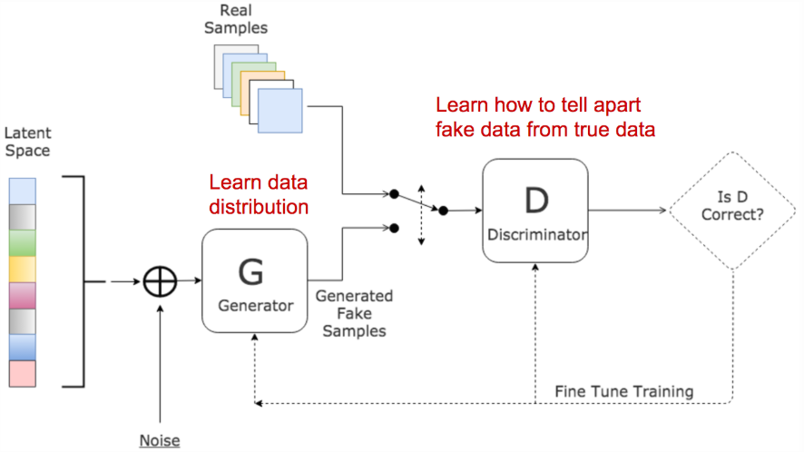
Brief Idea of GAN
Image source: https://www.kdnuggets.com/2017/01/generative-adversarial-networks-hot-topic-machine-learning.html

Slide 8
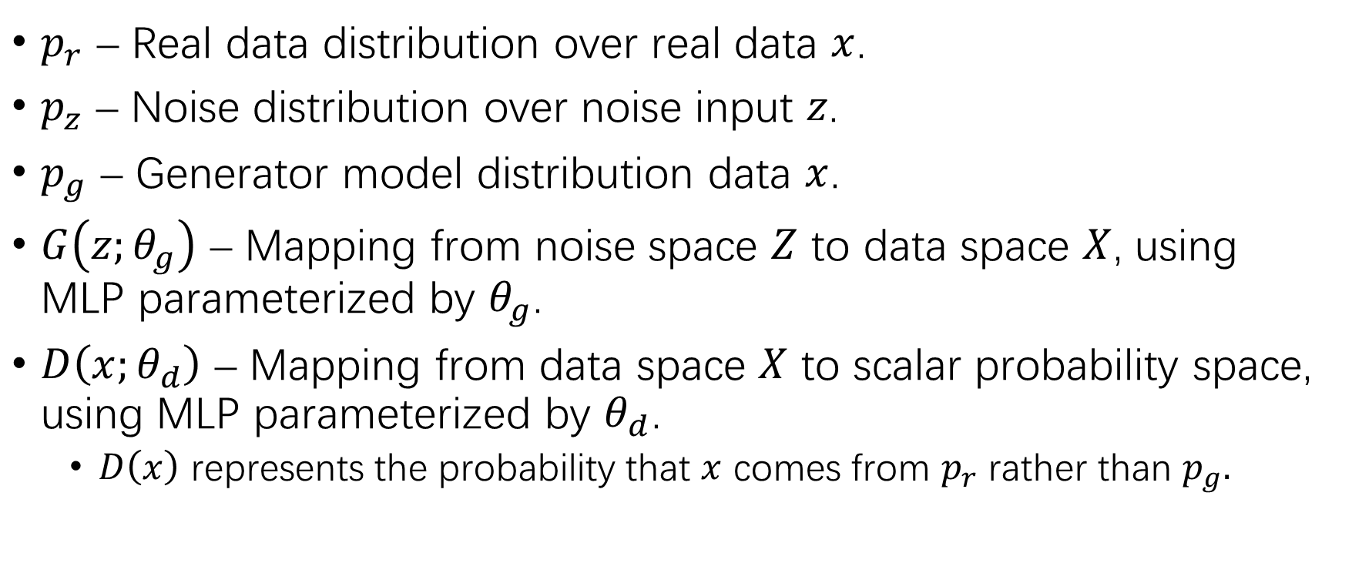
Definitions
$p_{r}$ – Real data distribution over real data $x$.
$p_{z}$ – Noise distribution over noise input $z$.
$p_{g}$ – Generator model distribution data $x$.
$G\left(z;θ_{g}\right)$ – Mapping from noise space $Z$ to data space $X$, using MLP parameterized by $θ_{g}$.
$D\left(x;θ_{d}\right)$ – Mapping from data space $X$ to scalar probability space, using MLP parameterized by $θ_{d}$.
$D\left(x\right)$ represents the probability that $x$ comes from $p_{r}$ rather than $p_{g}.$

Slide 9
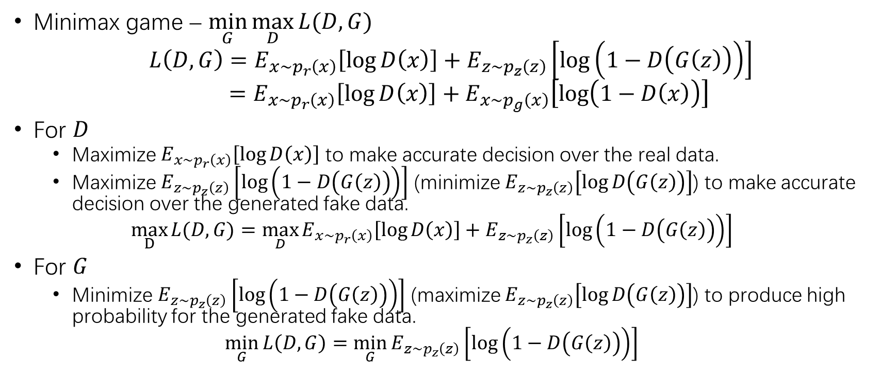
Minimax Game
Minimax game – $\min_{G}\max_{D}{L(D,G)}$
$$L\left(D,G\right)=E_{x\sim p_{r}\left(x\right)}\left[\log{D\left(x\right)}\right]+E_{z\sim p_{z}\left(z\right)}\left[\log\left(1−D\left(G\left(z\right)\right)\right)\right]$$
$$=E_{x\sim p_{r}\left(x\right)}\left[\log{D\left(x\right)}\right]+E_{x\sim p_{g}\left(x\right)}\left[\log\left(1−D\left(x\right)\right)\right]$$
For $D$
Maximize $E_{x\sim p_{r}\left(x\right)}\left[\log{D\left(x\right)}\right]$ to make accurate decision over the real data.
Maximize $E_{z\sim p_{z}\left(z\right)}\left[\log\left(1−D\left(G\left(z\right)\right)\right)\right]$ (minimize $E_{z\sim p_{z}\left(z\right)}\left[\log{D\left(G\left(z\right)\right)}\right]$) to make accurate decision over the generated fake data.
$$\max_{D}{L(D,G)}=\max_{D}{E_{x\sim p_{r}\left(x\right)}\left[\log{D\left(x\right)}\right]+E_{z\sim p_{z}\left(z\right)}\left[\log\left(1−D\left(G\left(z\right)\right)\right)\right]}$$
For $G$
Minimize $E_{z\sim p_{z}\left(z\right)}\left[\log\left(1−D\left(G\left(z\right)\right)\right)\right]$ (maximize $E_{z\sim p_{z}\left(z\right)}\left[\log{D\left(G\left(z\right)\right)}\right]$) to produce high probability for the generated fake data.
$$\min_{G}{L\left(D,G\right)=\min_{G}{E_{z\sim p_{z}\left(z\right)}\left[\log\left(1−D\left(G\left(z\right)\right)\right)\right]}}$$

Slide 10
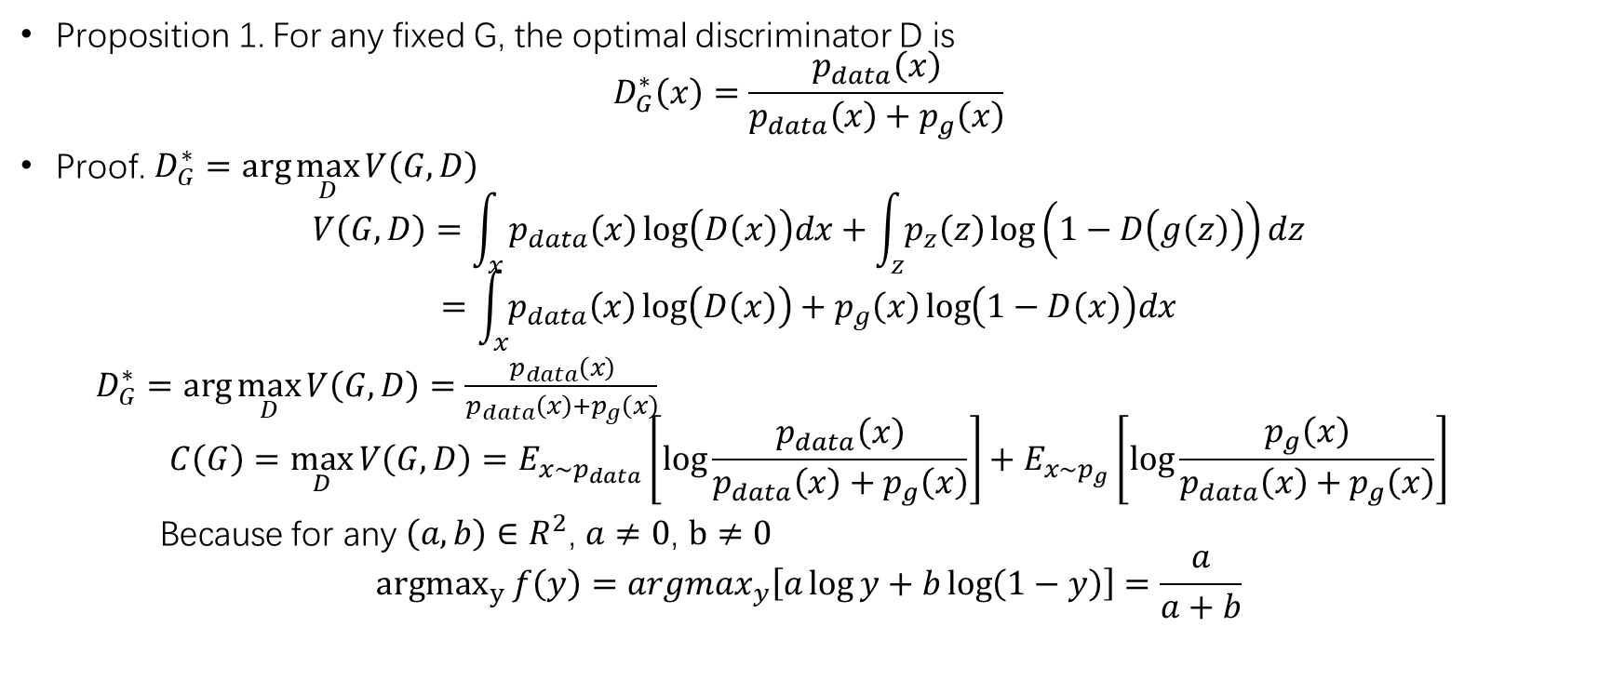
Global Optimality – Optimal Discriminator
Proposition 1. For any fixed G, the optimal discriminator D is
$$D_{G}^{∗}\left(x\right)=\frac{p_{data}\left(x\right)}{p_{data}\left(x\right)+p_{g}\left(x\right)}$$
Proof. $D_{G}^{∗}=\arg{\max_{D}{V\left(G,D\right)}}$
$$V\left(G,D\right)=\int_{x}{p_{data}\left(x\right)\log\left(D\left(x\right)\right)dx+\int_{z}{p_{z}\left(z\right)\log\left(1−D\left(g\left(z\right)\right)\right)dz}}$$
$$=\int_{x}{p_{data}\left(x\right)\log\left(D\left(x\right)\right)+p_{g}\left(x\right)\log\left(1−D\left(x\right)\right)dx}$$
$D_{G}^{∗}=\arg{\max_{D}{V\left(G,D\right)}}=\frac{p_{data}\left(x\right)}{p_{data}\left(x\right)+p_{g}\left(x\right)}$
$$C\left(G\right)=\max_{D}{V\left(G,D\right)}=E_{x\sim p_{data}}\left[\log{\frac{p_{data}\left(x\right)}{p_{data}\left(x\right)+p_{g}\left(x\right)}}\right]+E_{x\sim p_{g}}\left[\log{\frac{p_{g}\left(x\right)}{p_{data}\left(x\right)+p_{g}\left(x\right)}}\right]$$
Because for any $\left(a,b\right)∈R^{2}$, $a≠0$, $b≠0$
$${argmax}_{y} f\left(y\right)=argmax_{y}\left[a\log{y}+b\log\left(1−y\right)\right]=\frac{a}{a+b}$$

Slide 11
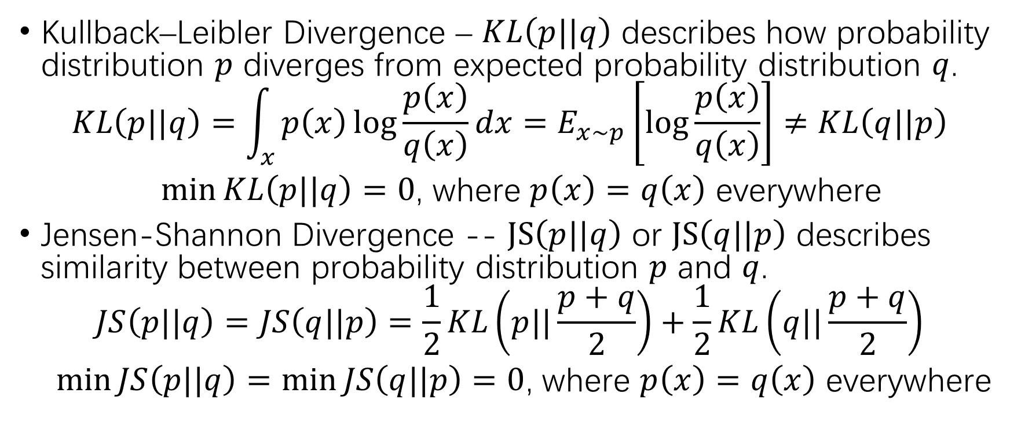
Interruption!
Kullback–Leibler Divergence – $KL\left(p||q\right)$ describes how probability distribution $p$ diverges from expected probability distribution $q$.
$$KL\left(p||q\right)=\int_{x}{p\left(x\right)\log{\frac{p\left(x\right)}{q\left(x\right)}}dx}=E_{x\sim p}\left[\log{\frac{p\left(x\right)}{q\left(x\right)}}\right]≠KL\left(q||p\right)$$
$\min{KL\left(p||q\right)=0}$, where $p\left(x\right)=q\left(x\right)$ everywhere
Jensen-Shannon Divergence -- $JS\left(p||q\right)$ or $JS\left(q||p\right)$ describes similarity between probability distribution $p$ and $q$.
$$JS\left(p||q\right)=JS\left(q||p\right)=\frac{1}{2}KL\left(p||\frac{p+q}{2}\right)+\frac{1}{2}KL\left(q||\frac{p+q}{2}\right)$$
$\min{JS\left(p||q\right)=\min{JS\left(q||p\right)}=0}$, where $p\left(x\right)=q\left(x\right)$ everywhere

Slide 12
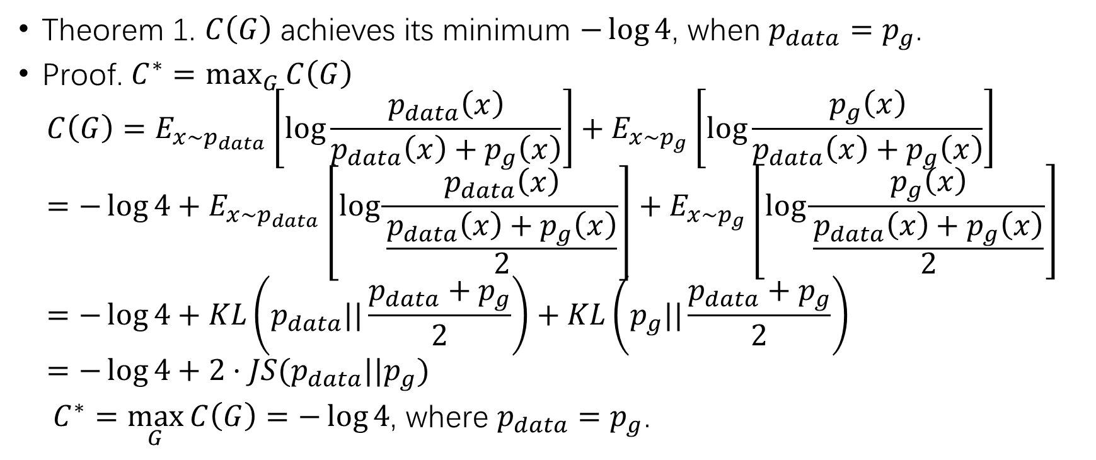
Global Optimality – Optimal Generator
Theorem 1. $C\left(G\right)$ achieves its minimum $−\log{4}$, when $p_{data}=p_{g}$.
Proof. $C^{∗}=\max_{G}{C\left(G\right)}$
$$C\left(G\right)=E_{x\sim p_{data}}\left[\log{\frac{p_{data}\left(x\right)}{p_{data}\left(x\right)+p_{g}\left(x\right)}}\right]+E_{x\sim p_{g}}\left[\log{\frac{p_{g}\left(x\right)}{p_{data}\left(x\right)+p_{g}\left(x\right)}}\right]=−\log{4}+E_{x\sim p_{data}}\left[\log{\frac{p_{data}\left(x\right)}{\frac{p_{data}\left(x\right)+p_{g}\left(x\right)}{2}}}\right]+E_{x\sim p_{g}}\left[\log{\frac{p_{g}\left(x\right)}{\frac{p_{data}\left(x\right)+p_{g}\left(x\right)}{2}}}\right]=−\log{4}+KL\left(p_{data}||\frac{p_{data}+p_{g}}{2}\right)+KL\left(p_{g}||\frac{p_{data}+p_{g}}{2}\right)=−\log{4}+2⋅JS(p_{data}||p_{g})$$
$C^{∗}=\max_{G}{C\left(G\right)}=−\log{4}$, where $p_{data}=p_{g}$.

Slide 13
Global Optimality – Implication
If the discriminator is always good at distinguishing the fake samples and the real samples, the generator is able to generate more vivid samples.
When the minimax game reaches its optimality, the distribution of the generated samples will be exactly same as the real distribution, which means the generator is able to generate “real samples”.
The loss function is essentially the similarity between the generated distribution and the real data distribution by JS divergence.

Slide 14
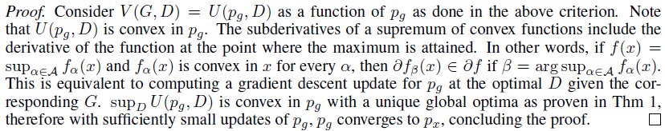
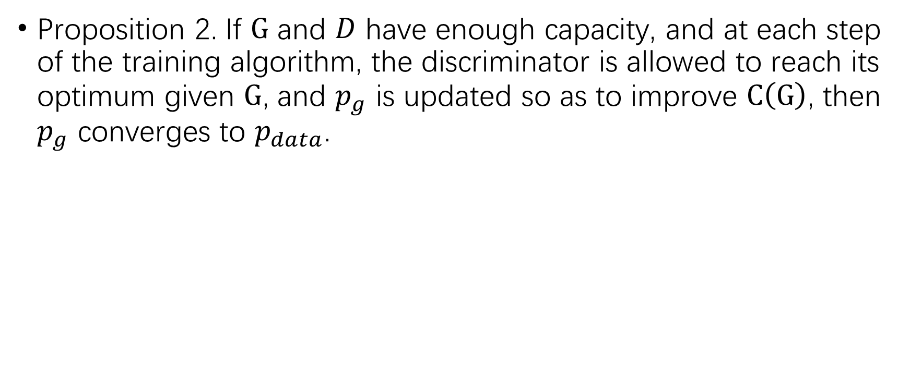
Convergence of the Training Algorithm
Proposition 2. If $G$ and $D$ have enough capacity, and at each step of the training algorithm, the discriminator is allowed to reach its optimum given $G$, and $p_{g}$ is updated so as to improve $C\left(G\right)$, then $p_{g}$ converges to $p_{data}$.

Slide 15
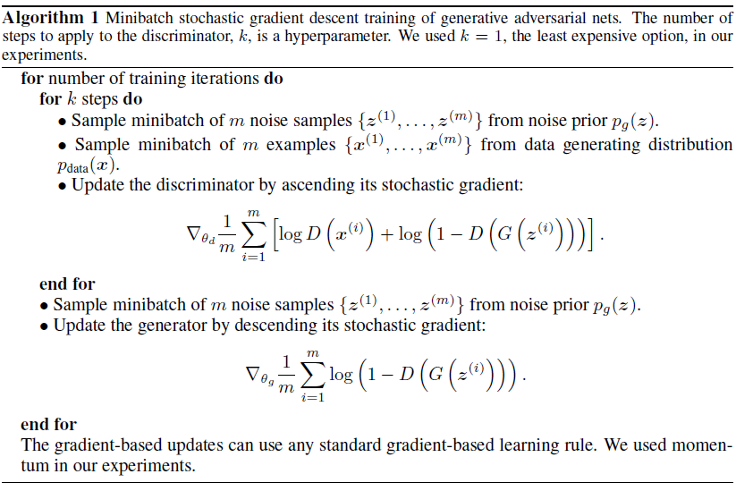
Training Algorithm
Begin
Sample
Update D
K iter?
Sample
Update G
End?
End

Slide 16
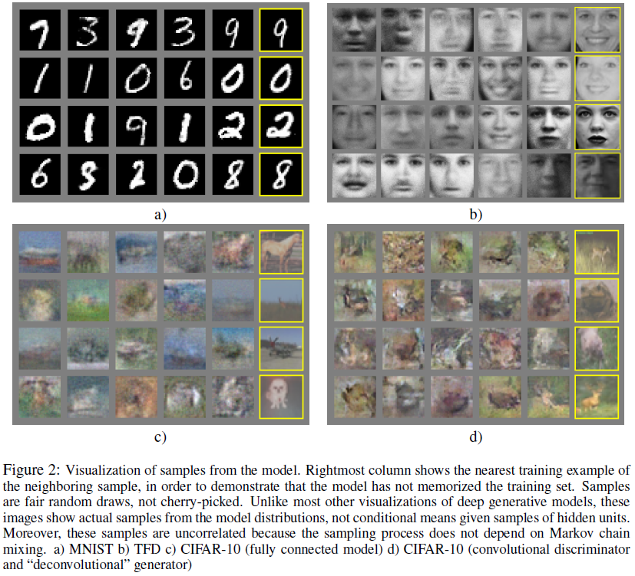
Results

Slide 17
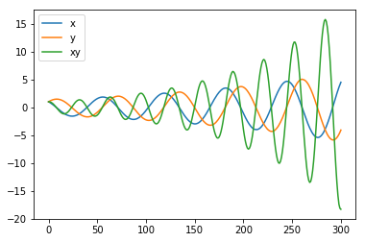
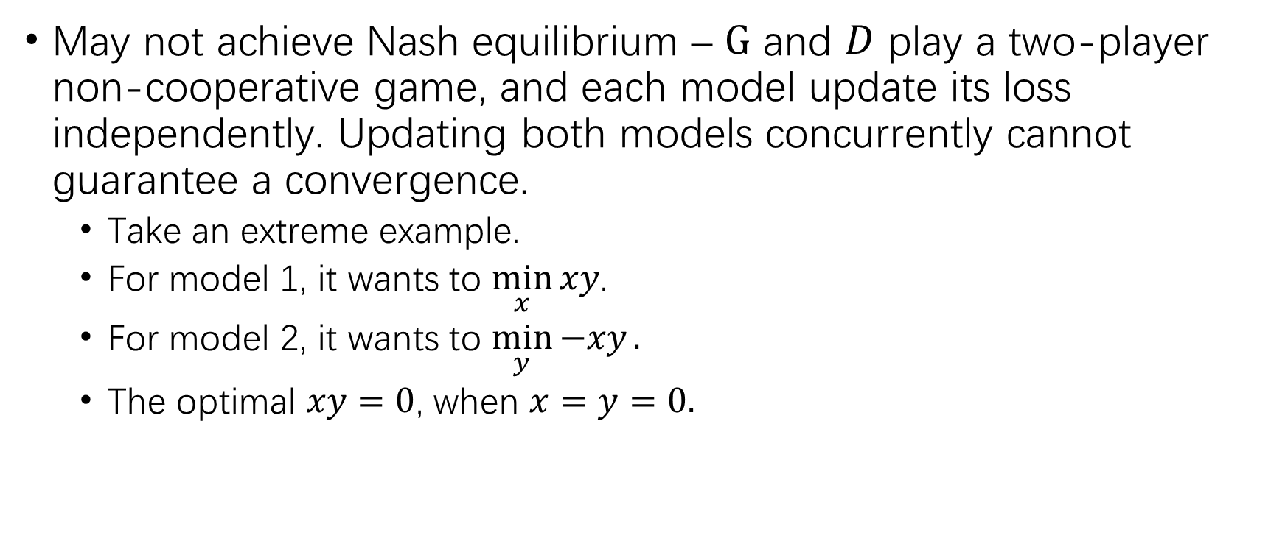
Challenges in GAN
May not achieve Nash equilibrium – $G$ and $D$ play a two-player non-cooperative game, and each model update its loss independently. Updating both models concurrently cannot guarantee a convergence.
Take an extreme example.
For model 1, it wants to $\min_{x}{xy}$.
For model 2, it wants to $\min_{y}{−xy}.$
The optimal $xy=0$, when $x=y=0.$

Slide 18
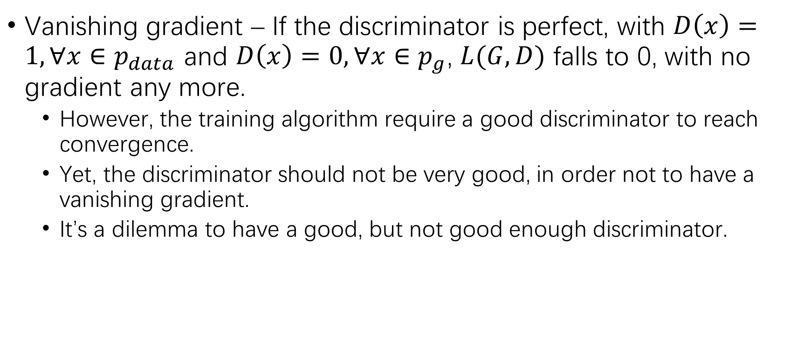
Challenges in GAN (2)
Vanishing gradient – If the discriminator is perfect, with $D\left(x\right)=1, ∀x∈p_{data}$ and $D\left(x\right)=0, ∀x∈p_{g}$, $L(G,D)$ falls to 0, with no gradient any more.
However, the training algorithm require a good discriminator to reach convergence.
Yet, the discriminator should not be very good, in order not to have a vanishing gradient.
It’s a dilemma to have a good, but not good enough discriminator.

Slide 19
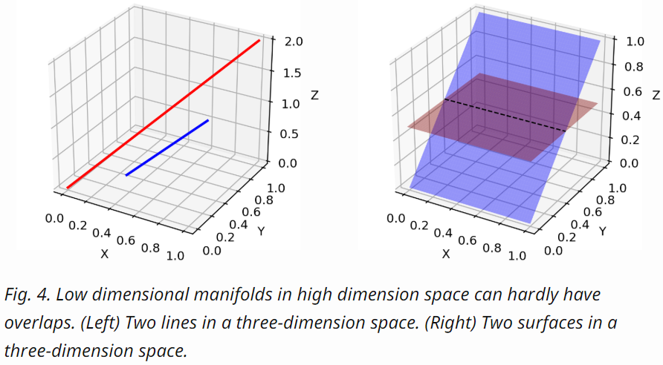
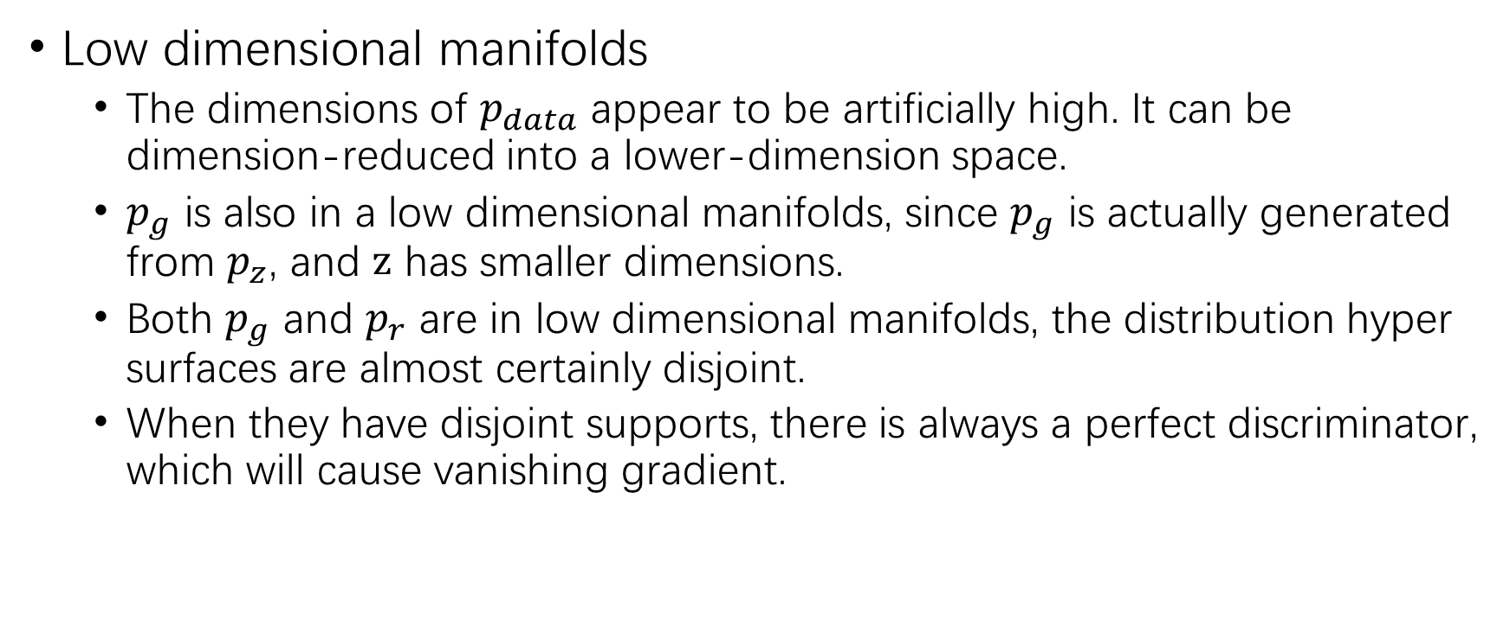
Challenges in GAN (3)
Low dimensional manifolds
The dimensions of $p_{data}$ appear to be artificially high. It can be dimension-reduced into a lower-dimension space.
$p_{g}$ is also in a low dimensional manifolds, since $p_{g}$ is actually generated from $p_{z}$, and $z$ has smaller dimensions.
Both $p_{g}$ and $p_{r}$ are in low dimensional manifolds, the distribution hyper surfaces are almost certainly disjoint.
When they have disjoint supports, there is always a perfect discriminator, which will cause vanishing gradient.
Image source: https://lilianweng.github.io/lil-log/2017/08/20/from-GAN-to-WGAN.html#low-dimensional-supports

Slide 20
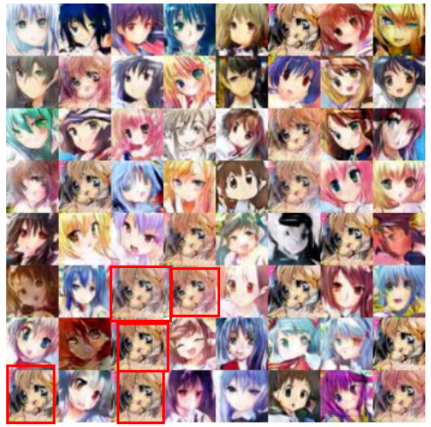
Challenges in GAN (4)
Mode collapse – The generator collapse to a setting where it always produces same outputs.
Image source: https://blog.csdn.net/SPARKKKK/article/details/72598041?locationNum=10&fps=1

Slide 21
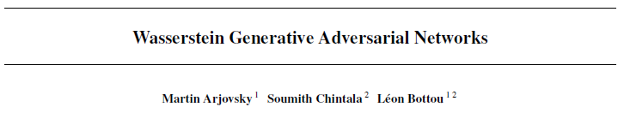
Wasserstein Generative Adversarial Networks (WGAN)

Slide 22
Why WGAN?
Wasserstein metric provides a smoother loss function than JS divergence.
WGAN is empirically more easy to train, for the balance between the generator and the discriminator is not required maintaining.
WGAN gets rid of the problem of mode collapse.
… …

Slide 23
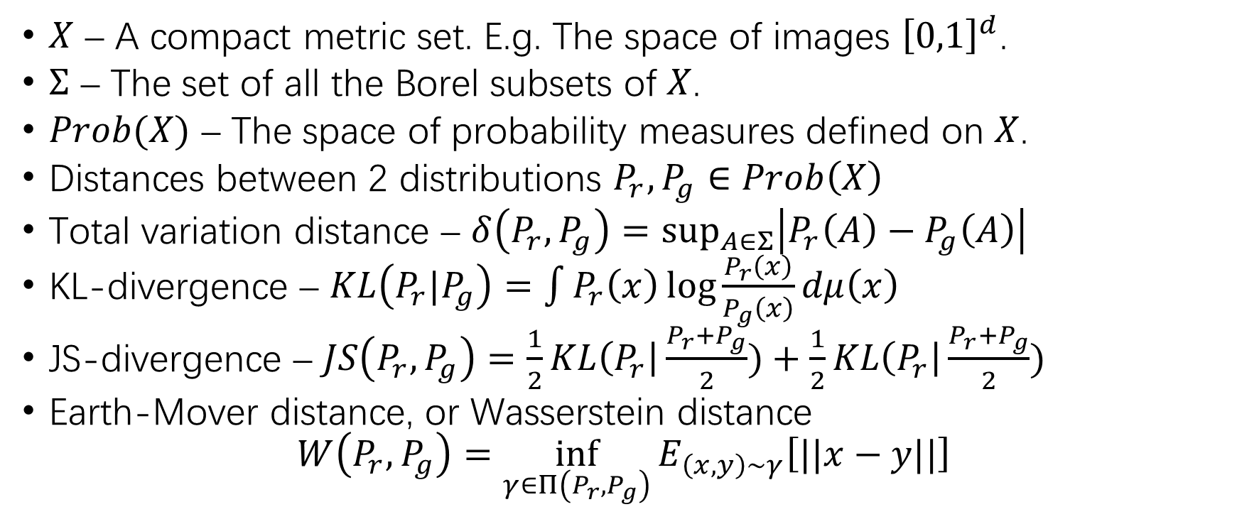
Different Distances
$X$ – A compact metric set. E.g. The space of images ${\left[0,1\right]}^{d}$.
$Σ$ – The set of all the Borel subsets of $X$.
$Prob(X)$ – The space of probability measures defined on $X$.
Distances between 2 distributions $P_{r},P_{g}∈Prob\left(X\right)$
Total variation distance – $δ\left(P_{r},P_{g}\right)=\sup_{A∈Σ}\left|P_{r}\left(A\right)−P_{g}\left(A\right)\right|$
KL-divergence – $KL\left(P_{r}|P_{g}\right)=\int{P_{r}\left(x\right)\log{\frac{P_{r}\left(x\right)}{P_{g}\left(x\right)}}dμ\left(x\right)}$
JS-divergence – $JS\left(P_{r},P_{g}\right)=\frac{1}{2}KL\left(P_{r}\right|\frac{P_{r}+P_{g}}{2})+\frac{1}{2}KL\left(P_{r}\right|\frac{P_{r}+P_{g}}{2})$
Earth-Mover distance, or Wasserstein distance
$$W\left(P_{r},P_{g}\right)=\inf_{γ∈Π\left(P_{r},P_{g}\right)}{E_{\left(x,y\right)∼γ}\left[||x−y||\right]}$$

Slide 24
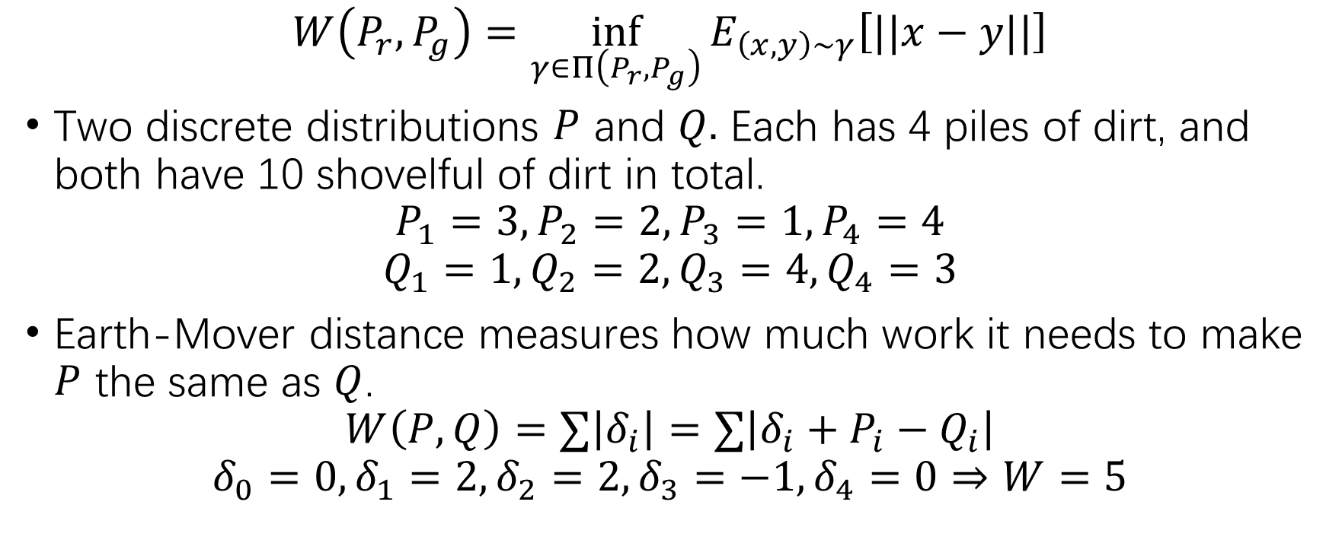
Earth-Mover Distance
$$W\left(P_{r},P_{g}\right)=\inf_{γ∈Π\left(P_{r},P_{g}\right)}{E_{\left(x,y\right)∼γ}\left[||x−y||\right]}$$
Two discrete distributions $P$ and $Q.$ Each has 4 piles of dirt, and both have 10 shovelful of dirt in total.
$$P_{1}=3, P_{2}=2, P_{3}=1, P_{4}=4$$
$$Q_{1}=1, Q_{2}=2, Q_{3}=4, Q_{4}=3$$
Earth-Mover distance measures how much work it needs to make $P$ the same as $Q$.
$$W\left(P,Q\right)=∑\left|δ_{i}\right|=∑\left|δ_{i}+P_{i}−Q_{i}\right|$$
$$δ_{0}=0, δ_{1}=2, δ_{2}=2, δ_{3}=−1, δ_{4}=0⇒W=5$$

Slide 25
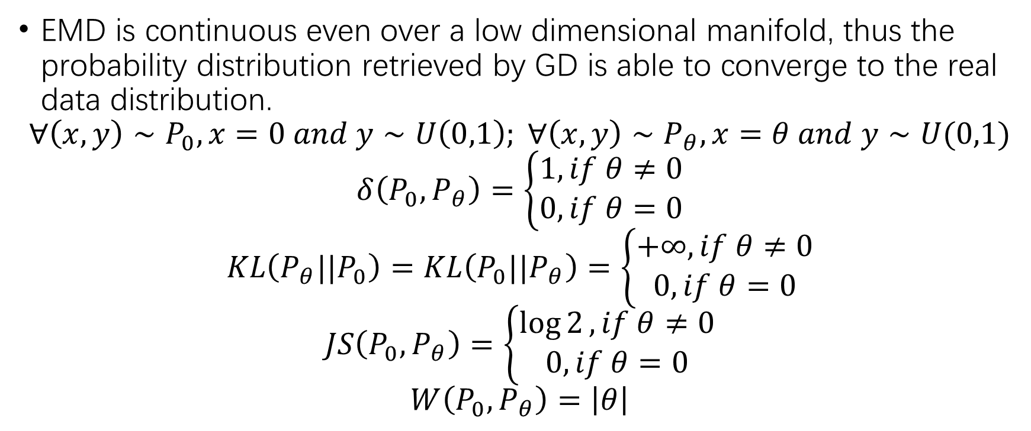
Benefit of EMD – Continuity
EMD is continuous even over a low dimensional manifold, thus the probability distribution retrieved by GD is able to converge to the real data distribution.
$$∀\left(x,y\right)∼P_{0}, x=0 and y∼U\left(0,1\right); ∀\left(x,y\right)∼P_{θ}, x=θ and y∼U(0,1)$$
$$δ\left(P_{0},P_{θ}\right)=\left\{\begin{aligned}1, if θ≠0 \\ 0, if θ=0\end{aligned}\right.$$
$$KL\left(P_{θ}||P_{0}\right)=KL\left(P_{0}||P_{θ}\right)=\left\{\begin{aligned}+∞, if θ≠0 \\ 0, if θ=0\end{aligned}\right.$$
$$JS\left(P_{0},P_{θ}\right)=\left\{\begin{aligned}\log{2}, if θ≠0 \\ 0, if θ=0\end{aligned}\right.$$
$$W\left(P_{0},P_{θ}\right)=\left|θ\right|$$

Slide 26
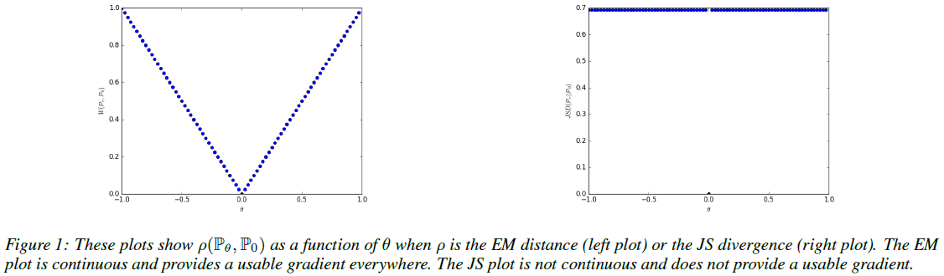
Benefit of EMD – Continuity (2)

Slide 27
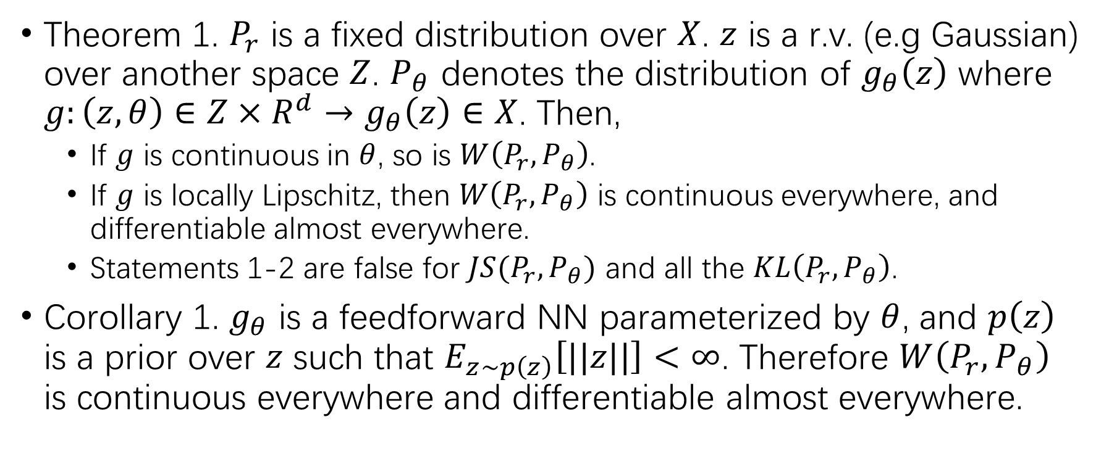
Benefit of EMD – Continuity (3)
Theorem 1. $P_{r}$ is a fixed distribution over $X$. $z$ is a r.v. (e.g Gaussian) over another space $Z$. $P_{θ}$ denotes the distribution of $g_{θ}\left(z\right)$ where $g:\left(z, θ\right)∈Z×R^{d}→g_{θ}\left(z\right)∈X$. Then,
If $g$ is continuous in $θ$, so is $W\left(P_{r}, P_{θ}\right)$.
If $g$ is locally Lipschitz, then $W\left(P_{r},P_{θ}\right)$ is continuous everywhere, and differentiable almost everywhere.
Statements 1-2 are false for $JS(P_{r},P_{θ})$ and all the $KL\left(P_{r},P_{θ}\right)$.
Corollary 1. $g_{θ}$ is a feedforward NN parameterized by $θ$, and $p\left(z\right)$ is a prior over $z$ such that $E_{z∼p\left(z\right)}\left[||z||\right]<∞$. Therefore $W\left(P_{r},P_{θ}\right)$ is continuous everywhere and differentiable almost everywhere.

Slide 28
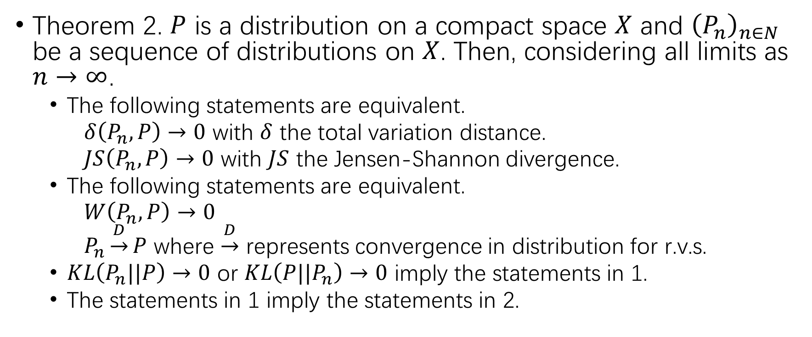
Benefit of EMD – Continuity (4)
Theorem 2. $P$ is a distribution on a compact space $X$ and ${\left(P_{n}\right)}_{n∈N}$ be a sequence of distributions on $X$. Then, considering all limits as $n→∞$.
The following statements are equivalent.
$δ\left(P_{n},P\right)→0$ with $δ$ the total variation distance.
$JS\left(P_{n},P\right)→0$ with $JS$ the Jensen-Shannon divergence.
The following statements are equivalent.
$W\left(P_{n},P\right)→0$
$P_{n}\underset{→}{D}P$ where $\underset{→}{D}$ represents convergence in distribution for r.v.s.
$KL\left(P_{n}||P\right)→0$ or $KL\left(P||P_{n}\right)→0$ imply the statements in 1.
The statements in 1 imply the statements in 2.

Slide 29
Benefit of EMD – Continuity (5)
Theorem 1 and corollary 1 indicates that EMD is a much more sensible loss function for the problem than the JSD.
Theorem 2 points to the fact that EMD might have nicer properties when optimized than JSD.

Slide 30
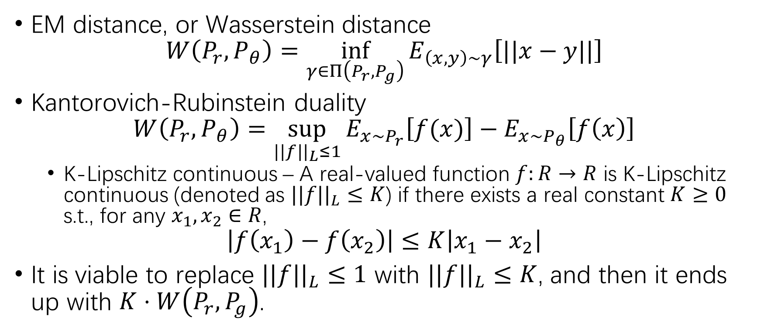
Wasserstein GAN
EM distance, or Wasserstein distance
$$W\left(P_{r},P_{θ}\right)=\inf_{γ∈Π\left(P_{r},P_{g}\right)}{E_{\left(x,y\right)∼γ}\left[||x−y||\right]}$$
Kantorovich-Rubinstein duality
$$W\left(P_{r},P_{θ}\right)=\sup_{||f||_{L}≤1}{E_{x∼P_{r}}\left[f(x)\right]−E_{x∼P_{θ}}\left[f\left(x\right)\right]}$$
K-Lipschitz continuous – A real-valued function $f:R→R$ is K-Lipschitz continuous (denoted as $||f||_{L}≤K$) if there exists a real constant $K≥0$ s.t., for any $x_{1},x_{2}∈R$,
$$\left|f\left(x_{1}\right)−f\left(x_{2}\right)\right|≤K\left|x_{1}−x_{2}\right|$$
It is viable to replace $||f||_{L}≤1$ with $||f||_{L}≤K$, and then it ends up with $K⋅W\left(P_{r},P_{g}\right)$.

Slide 31
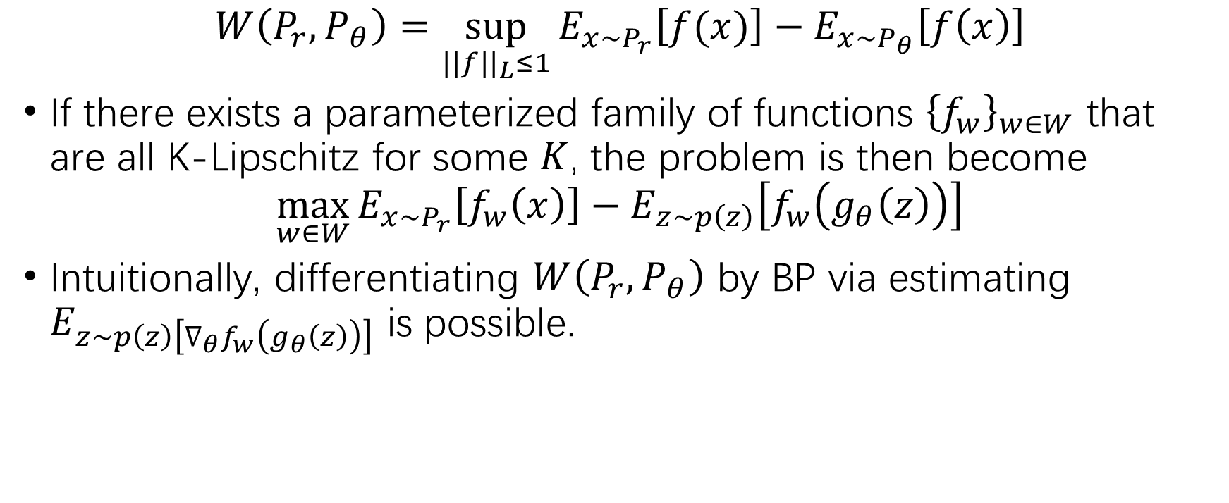
Wasserstein GAN (2)
$$W\left(P_{r},P_{θ}\right)=\sup_{||f||_{L}≤1}{E_{x∼P_{r}}\left[f(x)\right]−E_{x∼P_{θ}}\left[f\left(x\right)\right]}$$
If there exists a parameterized family of functions ${\left\{f_{w}\right\}}_{w∈W}$ that are all K-Lipschitz for some $K$, the problem is then become
$$\max_{w∈W}{E_{x∼P_{r}}\left[f_{w}\left(x\right)\right]−E_{z∼p\left(z\right)}\left[f_{w}\left(g_{θ}\left(z\right)\right)\right]}$$
Intuitionally, differentiating $W\left(P_{r},P_{θ}\right)$ by BP via estimating $E_{z∼p\left(z\right)\left[∇_{θ}f_{w}\left(g_{θ}\left(z\right)\right)\right]}$ is possible.

Slide 32
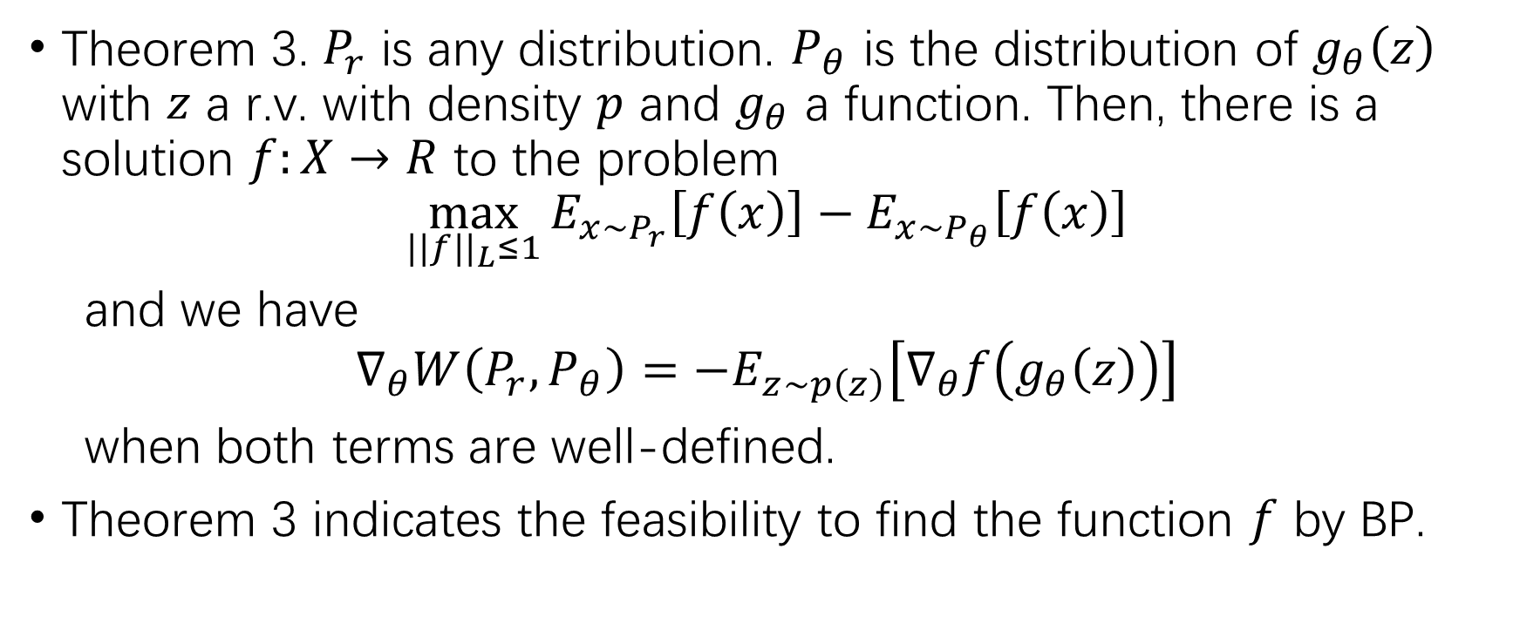
Wasserstein GAN (3)
Theorem 3. $P_{r}$ is any distribution. $P_{θ}$ is the distribution of $g_{θ}\left(z\right)$ with $z$ a r.v. with density $p$ and $g_{θ}$ a function. Then, there is a solution $f:X→R$ to the problem
$$\max_{||f||_{L}≤1}{E_{x∼P_{r}}\left[f\left(x\right)\right]−E_{x∼P_{θ}}\left[f\left(x\right)\right]}$$
and we have
$$∇_{θ}W\left(P_{r},P_{θ}\right)=−E_{z∼p\left(z\right)}\left[∇_{θ}f\left(g_{θ}\left(z\right)\right)\right]$$
when both terms are well-defined.
Theorem 3 indicates the feasibility to find the function $f$ by BP.

Slide 33
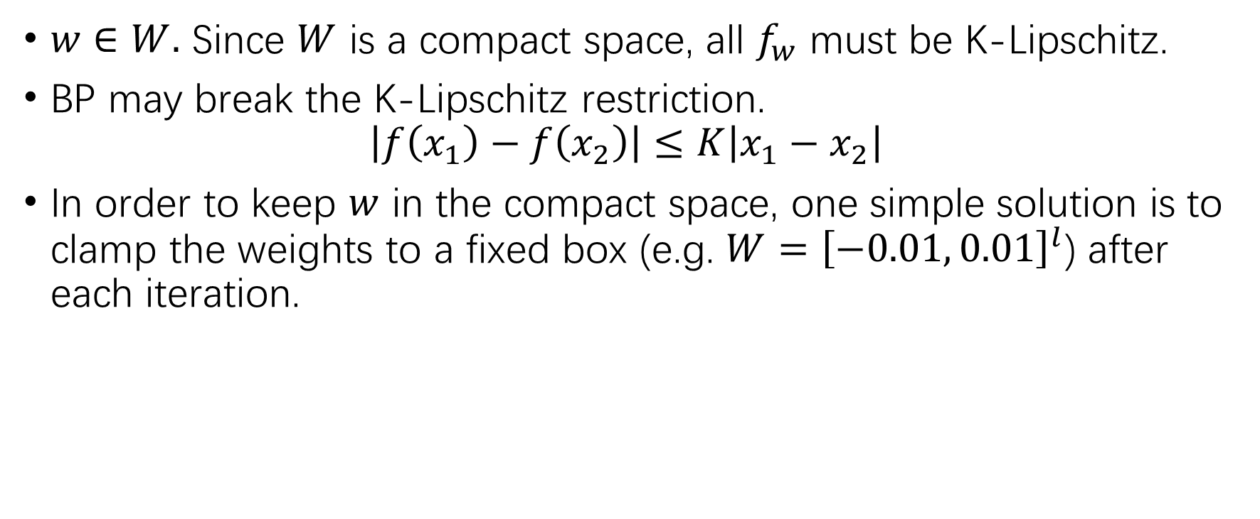
Wasserstein GAN (4)
$w∈W.$ Since $W$ is a compact space, all $f_{w}$ must be K-Lipschitz.
BP may break the K-Lipschitz restriction.
$$\left|f\left(x_{1}\right)−f\left(x_{2}\right)\right|≤K\left|x_{1}−x_{2}\right|$$
In order to keep $w$ in the compact space, one simple solution is to clamp the weights to a fixed box (e.g. $W={\left[−0.01, 0.01\right]}^{l}$) after each iteration.

Slide 34
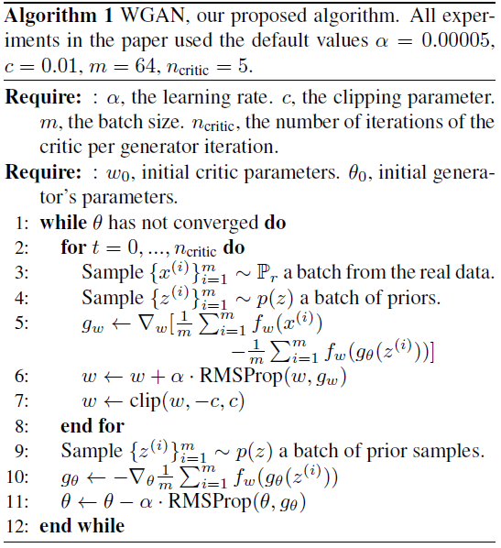
Training Algorithm

Slide 35
Retrospect!
GAN – Discriminator vs. generator.
The generator tries to generate samples to “outtrick” the discriminator.
The discriminator tries to distinguish the generated samples from the real samples, by outputting the probability that the sample is real (“is it real”).
Use JS-divergence as the loss function.
WGAN – Wasserstein distance metric.
The generator still tries to generate “real” samples.
The discriminator learns to compute the Wasserstein distance, and helps the generator figuring out “what is real”.

Slide 36
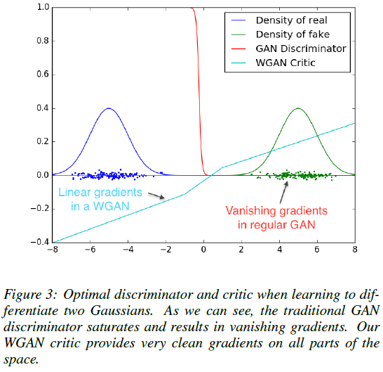
Facing the Challenges in GAN
Support problem on low dimensional manifolds – EM distance is immune to this problem, as explained.
Vanishing gradient – EM distance is continuous, and will not have a locally saturated point as the JS-divergence, which will lead to 0 gradient.

Slide 37
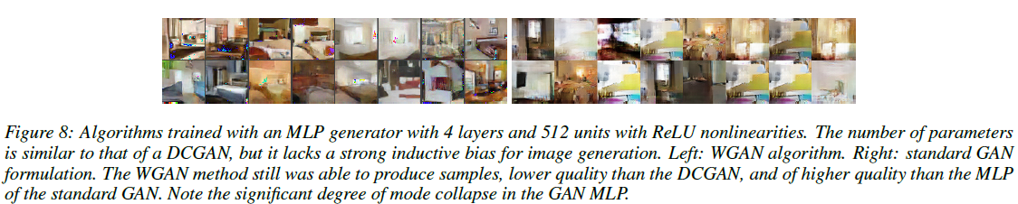
Facing the Challenges in GAN (2)
Mode collapse – Not any mode collapse found in WGAN.

Slide 38
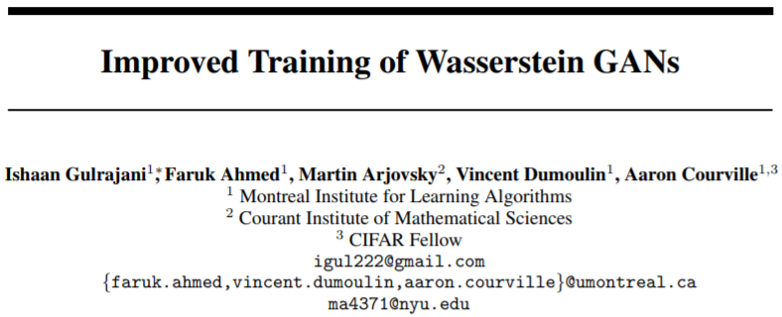
WGAN with Gradient Penalty

Slide 39
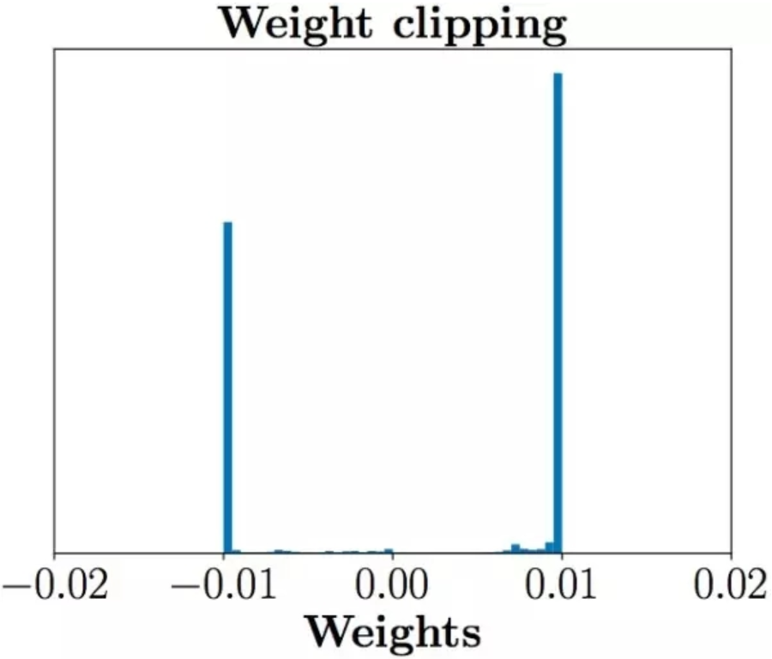
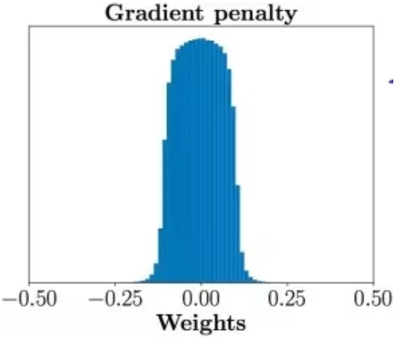
Inelegance in WGAN – Weight clipping
Weight clipping – Manually clamp the weights to a fixed box after each iteration, in order to keep the K-Lipschitz property.
The weights tend to be minimum, or maximum of the fixed box values, which leads to a very simple mapping (even a binary network), instead of some other complex mapping.
Image source: http://www.dataguru.cn/article-11229-1.html

Slide 40
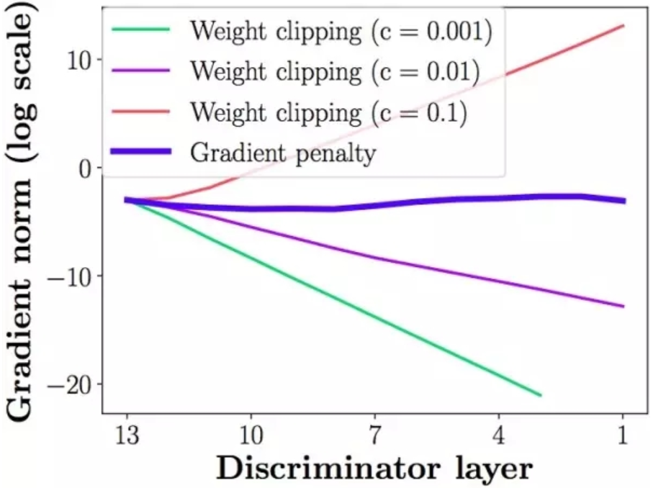
Inelegance in WGAN – Weight clipping (2)
Vanishing gradient & exploding gradient
A smaller clipping threshold may cause vanishing gradient, since the gradient value gets smaller after each layer.
A greater clipping threshold may cause exploding gradient, since the gradient value gets greater after each layer.
Image source: http://www.dataguru.cn/article-11229-1.html

Slide 41
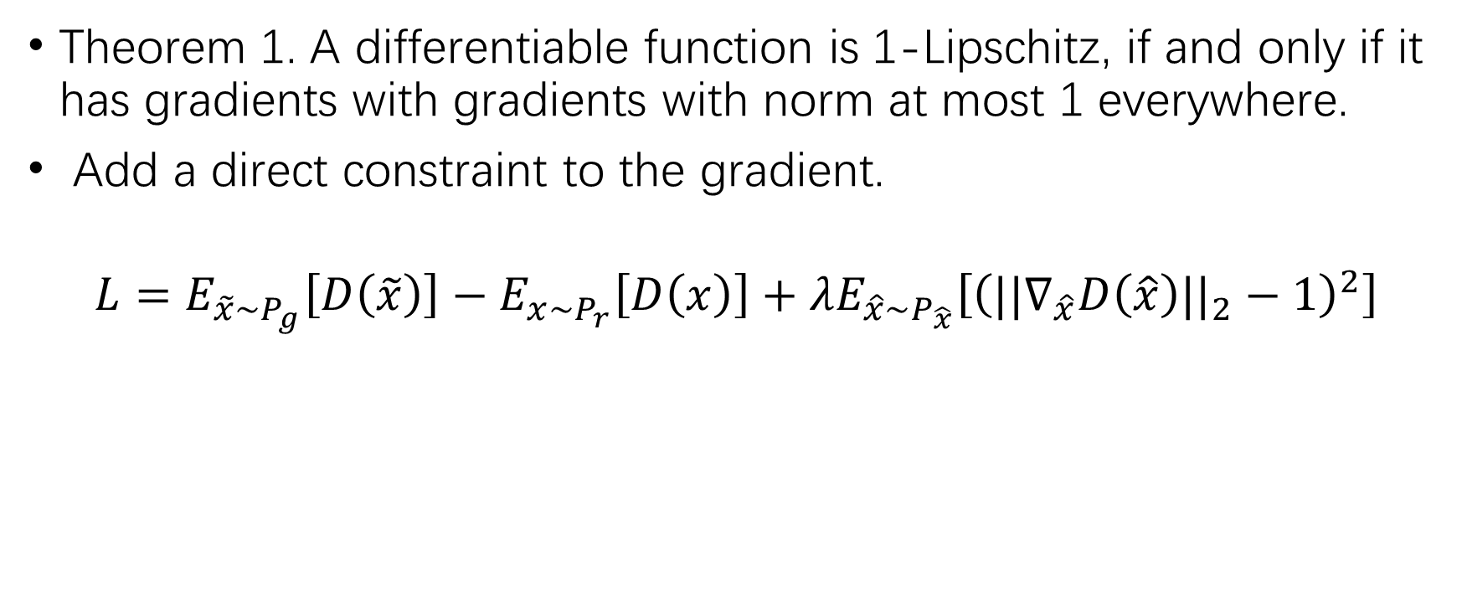
Gradient Penalty
Theorem 1. A differentiable function is 1-Lipschitz, if and only if it has gradients with gradients with norm at most 1 everywhere.
Add a direct constraint to the gradient.
$$L=E_{\tilde{x}∼P_{g}}\left[D\left(\tilde{x}\right)\right]−E_{x∼P_{r}}\left[D\left(x\right)\right]+λE_{\hat{x}∼P_{\hat{x}}}\left[{\left(||∇_{\hat{x}}D\left(\hat{x}\right)||_{2}−1\right)}^{2}\right]$$

Slide 42
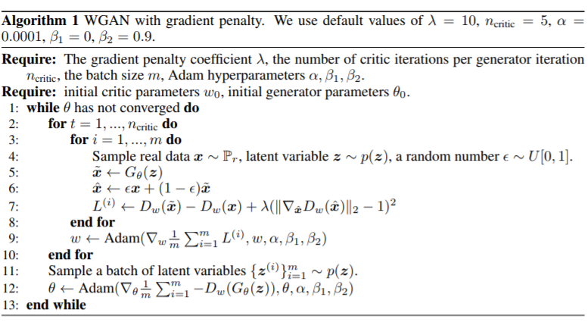
Gradient Penalty (2)

Slide 43
THANK YOU FOR LISTENING!

